Slide 1

PREDICTION OF DIABETES
POD
(USING MACHINE LEARNING TECHNIQUES)
By
Pradyumna Bandari (16BD1A0521) Nagarjuna Challa (16BD1A052Q) Chetan Sarda (16BD1A0532) Darshil Parekh (16BD1A053H)

Slide 2
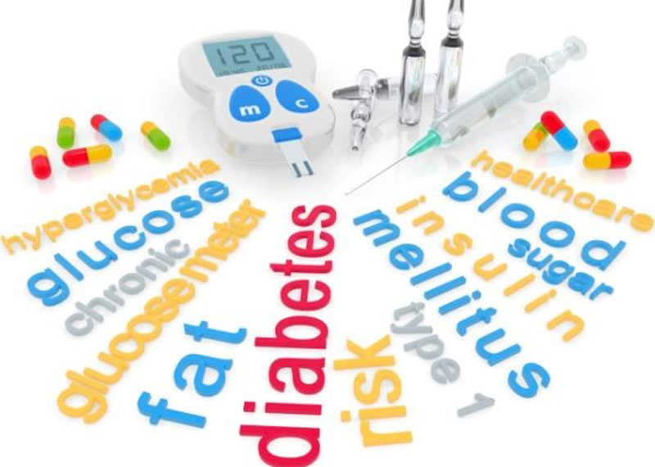
Diabetes
What ?
Risk factors ?
Causes ?
Types of Diabetes ?
Precautions
How to predict ?

Slide 3


Machine Learning
What ?
Why ?
Challenges of ML ?
Real world benefits of ML in Health care

Slide 4
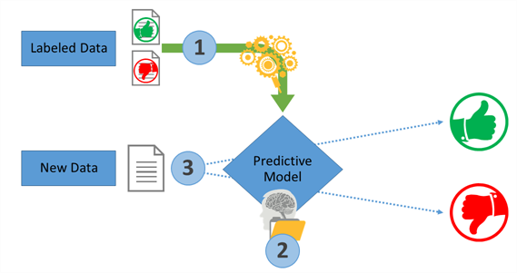
Regarding Project
It is a UI based correlational analysis for Diabetic prognosis which uses SVM technique.

Slide 5
Outline
Data Collection
Data Cleaning and Transformation
Splitting the dataset
Feature Scaling
Model Fitting
Model Tuning
Check Accuracy
Make a prediction

Slide 6
INTRODUCTION
Diabetes is one of the common and rapidly increasing diseases in the world. It is a major health problem in most of the countries. Diabetes is a condition in which your body is unable to produce the required amount of insulin needed to regulate the amount of sugar in the body. This leads to various diseases including heart disease, kidney disease, blindness, nerve damage and blood vessels damage. There are two general reasons for diabetes:
The pancreas does not make enough insulin or the body does not produce enough insulin. Only 5-10 % of people with diabetes have this form of the disease (Type-1).
Cells do not respond to the insulin that is produced (Type-2).

Slide 7
SOFTWARE REQUIREMENTS SPECIFICATION
Existing System
Now a days, the report for diabetes test is a very lengthy process. The typical recognizing process is that patients need to visit the diagnostic centre, consult specialist and sit tight for a day or more to get their reports.
Client Expectations
To make the diagnosis a much easy process , the clients are needed a system which outputs most accurate results and does not consume individual’s time and deviate him/her from his day to day routine
Proposed Solution
A medical diagnosis is a classification process. A physician has to analyze lot factors before diagnosing the diabetes which makes physician’s job difficult. So in order to make the procedure much easy and cost efficient one, we are using machine learning technique for predicting the status of diabetes in any person.

Slide 8
Functional Requirements
For documenting the functional requirements, the set of functionalities supported by the system are to be specified. A function can be specified by identifying the state at which data is to be input to the system, its input data domain, the output domain, and the type of processing to be carried on the input data to obtain the output.
Functional requirements define specific behaviour or function of the application.
Following are the functional requirements:
Should enter the details like Name, Age, BMI and Blood Pressure (BP).
Should press the PREDICT button to know the result.

Slide 9
Non Functional Requirements
A non-functional requirement is the one that specifies criteria that can be used to judge the operation of a system, rather than specific behaviour. Especially these are the constraints that the system must work within.
Following are the non functional requirements:
Should be available for installation on computer.
Crashing of application should not occur.
Response time for each query sent by the user should be minimum.
Application should be updated properly

Slide 10
Software and Hardware requirements
Operating System : Windows 7/8/10
Platform : Anaconda 1.6.14
Programming Language : Python 3.6.5
External Files : Dataset
Processor : Intel i3
Hard Disk :500 GB or More
RAM :4GB or More

Slide 11
LITERATURE SURVEY
Machine Learning
Software reliability
Supervised learning
Optimization
Main challenges of Machine Learning

Slide 12
DESIGN
Introduction to UML
The UML (Unified Modeling Language) is a way of visualizing a software program using a collection of diagrams. Today, UML is accepted by the Object Management Group (OMG) as the standard for modelling software development. UML stands for Unified Modelling Language. UML helped extend the original UML specification to cover a wider portion of software development efforts including agile practices.
Improved integration between structural models like class diagrams and behaviour models like activity diagrams

Slide 13
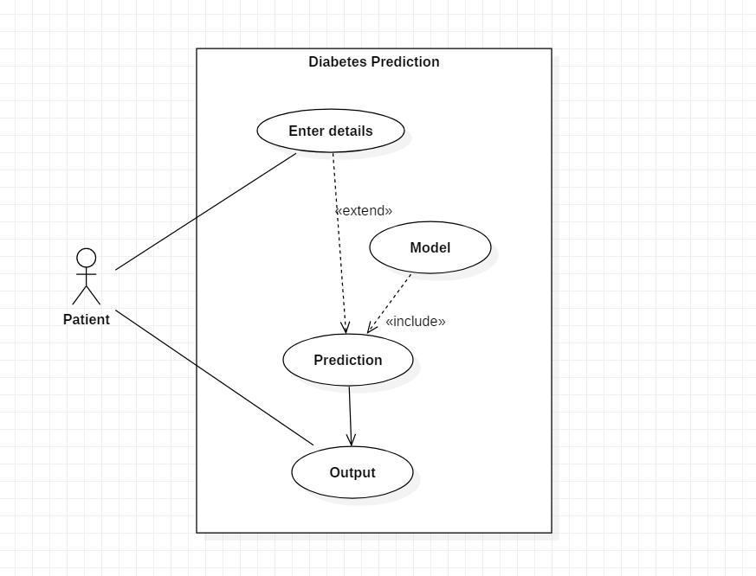
Use case Diagram
Use Case diagrams are used to analyze the system’s high-level requirements. These requirements are expressed through different use cases.
Functional requirements
Actors
Relationships

Slide 14
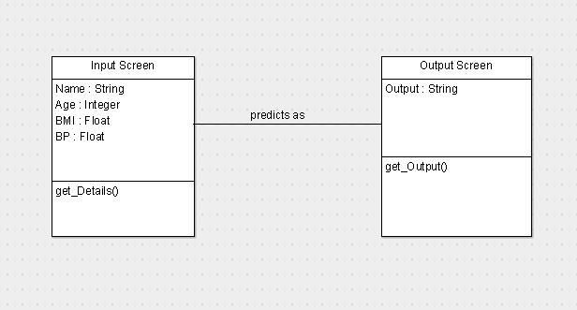
Class Diagram
Class diagrams contain classes, alongside with their attributes (also referred to as data fields) and their behaviours (also referred to as member functions).
More specifically, each class has 3 fields: the class name at the top, the class attributes right below the name, class operations/behaviours at the bottom. The relation between different classes (represented by a connecting line), makes up a class diagram.

Slide 15
Architecture Diagram

Slide 16
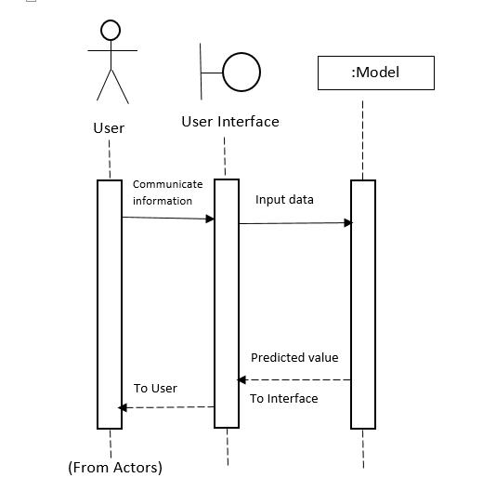
Sequence Diagram
These are probably the most important UML diagrams among not only the computer science community but also as design-level models for business application development. Lately, they have become popular in depicting business processes, because of their visually self-explanatory nature.

Slide 17
Activity Diagram
The basic purposes of activity diagrams is similar to other diagrams. It captures the dynamic behaviour of the system. Other diagrams are used to show the message flow from one object to another but activity diagram is used to show message flow from one activity to another.
Get Details
Prediction
Type – 2 Diabetes
No Diabetes
Output

Slide 18
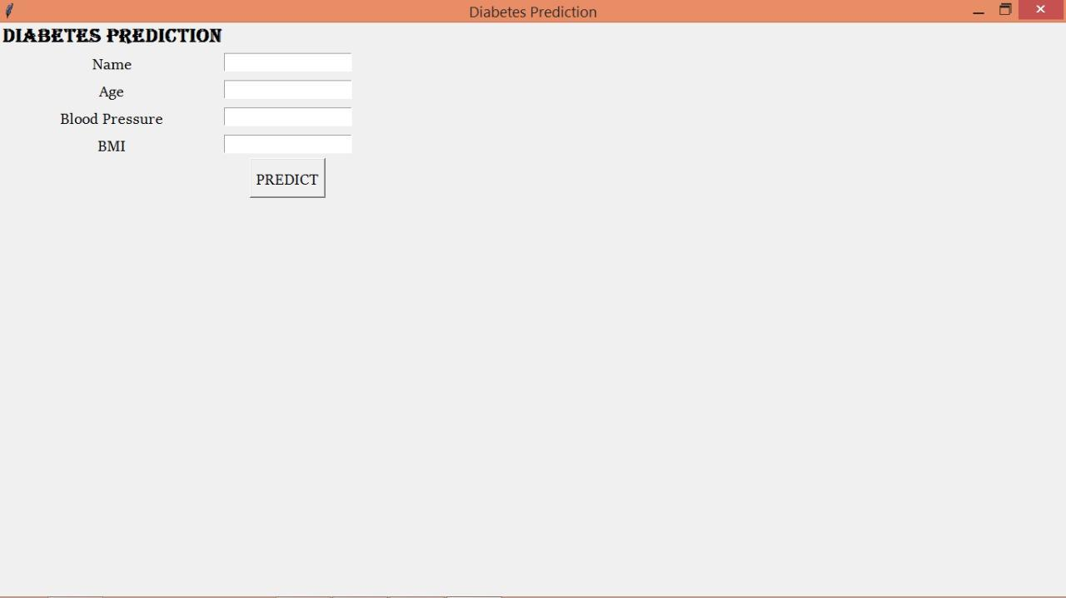
USER INTERFACE
Certain languages, such as HTML and CSS, have been geared toward making it easier to create a strong user interface and experience.

Slide 19
IMPLEMENTATION
Data goes through a series of steps during pre-processing:
● Data Cleaning: Data is cleansed through processes such as filling in missing values,
smoothing the noisy data, or resolving the inconsistencies in the data.
● Data Integration: Data with different representations are put together and conflicts within the data are resolved.
● Data Transformation: Data is normalized, aggregated and generalized.
● Data Reduction: This step aims to present a reduced representation of the data in a data warehouse.
● Data Discretization: Involves the reduction of a number

Slide 20
Dataset Description:

Slide 21
Dataset head

Slide 22
Visualize the dataset

Slide 23
Visualize the dataset (Conti)

Slide 24
Data Correlation Matrix

Slide 25
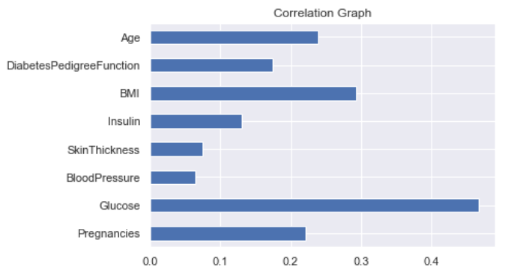
Why is correlation a useful metric ?
Helps in predicting one quantity from another .
It can indicate the presence of casual relationship .
Foundation for many modeling techniques .
Visualize predictors Correlation with outcome.
Factors like
Age
BMI
Blood pressure
influences the outcome .

Slide 26
Splitting of dataset :
Split into 80%/20% .
Feature Scaling :
Standardize the features of data .
Used for normalization in machine learning techniques .
Example : Support Vector Machines , Artificial Neural Networks etc.

Slide 27
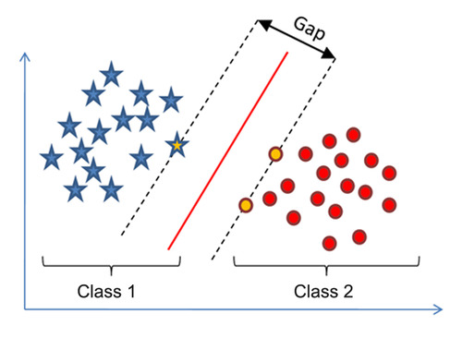
Support Vector Machine(SVM)
Supervised machine learning algorithm .
Elegant and powerful algorithm .
Based on concept of decision planes that define decision boundaries .
Best segregates the two classes(hyper-plane/line) .
Supports both classification and regression .

Slide 28
Model Fitting
#create instance for SVC
svc=SVC()
svc.fit(X_train_scaled,y_train)
SVC(C=1.0, cache_size=200, class_weight=None, coef0=0.0,
decision_function_shape='ovr', degree=3, gamma='auto', kernel='rbf',
max_iter=-1, probability=False, random_state=None, shrinking=True,
tol=0.001, verbose=False)
train_accuracy=svc.score(X_train_scaled,y_train)
test_accuracy=svc.score(X_test_scaled,y_test)
print("Accuracy on training set: ",train_accuracy)
print("Accuracy on testing set: ",test_accuracy)
Accuracy on training set: 0.6638078902229846
Accuracy on testing set: 0.5958904109589042

Slide 29
Model Tuning :
Process of maximizing model’s performance .
Selecting best parameters .
Optimizes the performance of algorithm .
Automated process .
Check Accuracy:
Before Tuning: Accuracy on training set - 66% Accuracy on testing set - 56%
After Tuning: Accuracy on training set - 72% Accuracy on testing set - 64%

Slide 30
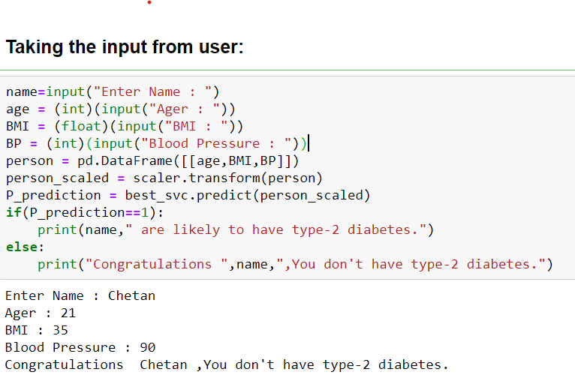
Make a Prediction

Slide 31
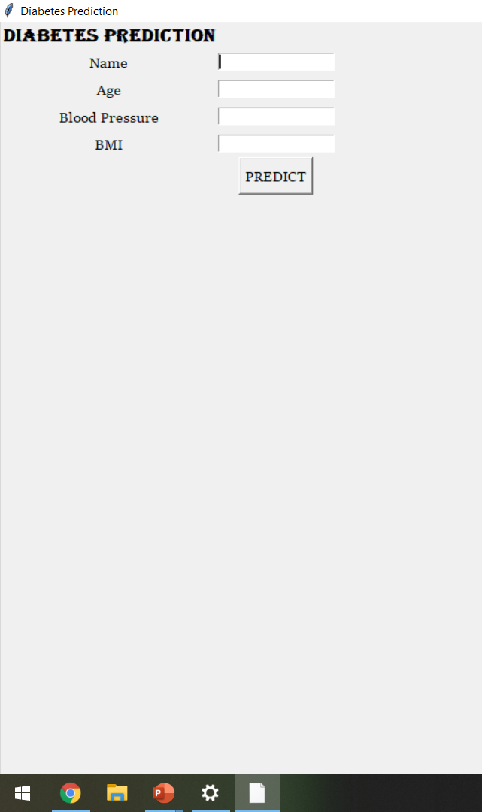
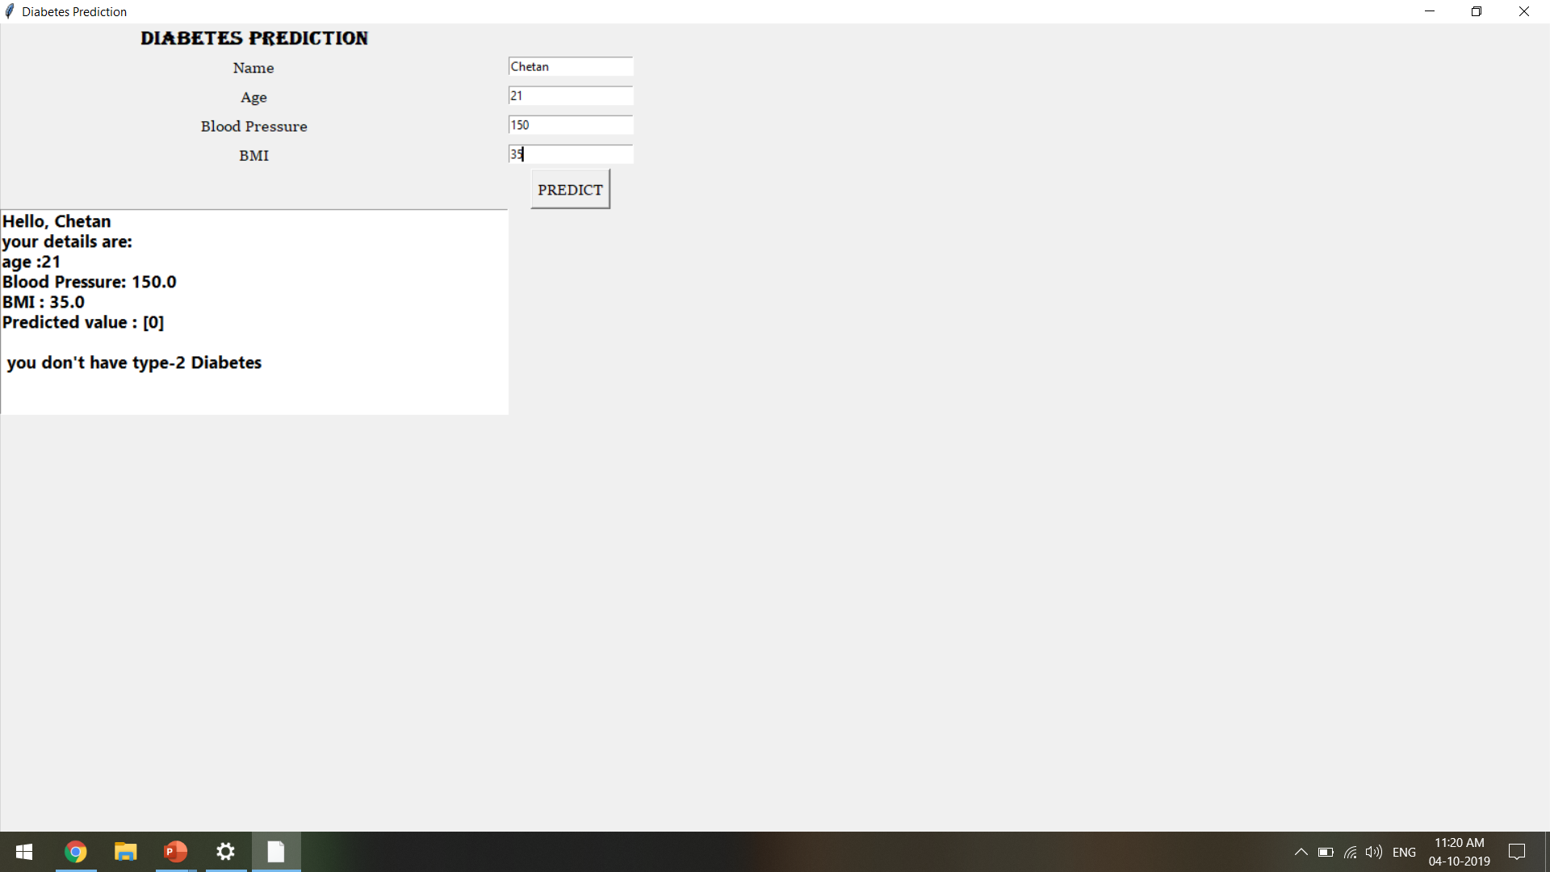
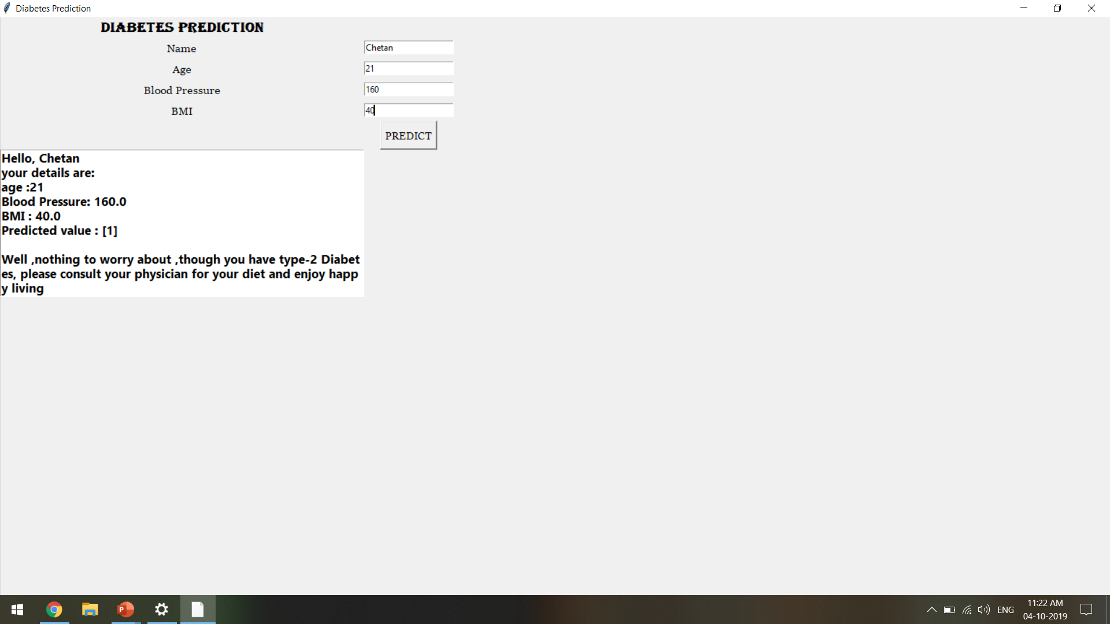
Output

Slide 32
Limitations
Accuracy is upto 64% .
Results are based on Correlational analysis of Pima Indians Diabetic Dataset .
Works only on Windows Operating System .

Slide 33
Conclusion
One of the effective ways to recognize whether one is diabetic or not .
Provides an easy way to recognize the disease .
Cost effective .

Slide 34
Thank You,
POD
Chetan Darshil
Nagarjuna Pradyumna
Keshav Memorial Institute Of Technology
34

